Slide 1

Database management system
Module Code: CSC5901
Olivier Kevin Angel ISHIMWE
6/25/2021
Course Code & Name
1

Slide 2
The Relational Database Model AND Entity Relationship diagram (Modelling)

Slide 3
Steps to Design a Database
(i) Determine the purpose of the Database
The first step in designing an SQL database is to determine the purpose of the database and how it's to be used. This tells you what information you want from the database. From that, you can determine what subjects you need to store facts about (the tables) and what facts you need to store about each subject (the fields in the tables). Talk to the people who will use the database.
Brain storm about the questions you'd like the database to answer and thereafter sketch out the reports you'd like it to produce. Gather the forms you currently use to record your data and you'll use all this information in the remaining steps of the design process.

Slide 4
(ii) Determine the tables you need.
Once you have a clear purpose for your database, you can divide your information into separate subjects, such as "Employees" or "Orders" Each subject will be a table in your database
(iii) Determine the fields you need.
Decide what information you want to keep in each table. Each category of information in a table is called a field and is displayed as a column in the table for example, one field in an Employees table could be “Last Name”; another could be “Date”

Slide 5
(iv) Determine the primary key fields
The power in a relational database management system such as SQL comes from its ability to quickly find and bring together information stored in separate tables. The primary key is an attribute (or attributes!) that uniquely identifies every record in the relation. In order for SQL/MS-Access to work most efficiently, each table in your database should include a field or set of fields that uniquely identifies each individual record stored in the table. This is often a unique identification number, such as an employee ID number or a serial number.

Slide 6
(v) Determine the relationships
Now that you've divided your information into tables, you need a way to tell SQL/ Microsoft Access how to bring it back together again in meaningful ways. SQL/Microsoft Access is a relational database management system. That means you store related data in separate tables. Then you define relationships between the tables, and Microsoft Access uses the relationships to find associated information stored in your database.
To set up the relationship correctly, you must first determine the nature of the relationship. There are basically three types of relationships between tables
One-to-many relationships
Many-to-many relationships
One-to-one relationships

Slide 7
Creating a One-to-Many Relationship
A one-to-many relationship is the most common type of relationship in a relational database. A relationship between tables is usually one-to-many affair. In a one-to-many relationship, a record in Table A can have more than one matching record in Table B, but a record in Table B has at most one matching record in Table A. For example a team has many players while players can play only for one team."
For example, the Suppliers and Products tables in the database have a one-to-many relationship as supplier can supply many products. For example, one class has many students assigned to it. But what if you need to assign MANY students to MANY classes?. To accomplish this, you can add a third table that acts as a go-between/junction table and handles all the possible combinations involved.

Slide 8
To set up the relationship, you add the field or fields that make up the primary key on the "one" side of the relationship to the table on the "many" side of the relationship. In this case, you would add the Supplier ID field from the Suppliers table to the Products table, because one supplier supplies many products. SQL/Microsoft Access uses the supplier ID number to locate the correct supplier for each product.

Slide 9
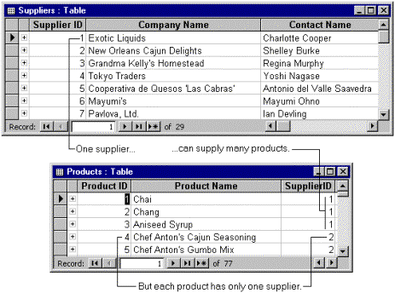

Slide 10
Creating Many-to-Many Relationships
This type of relationship takes place when many occurrences of an entity are related to many occurrences of the second entity and vice-versa. In order to support a many-to-many dimension relationship, a primary key–foreign key relationship must be defined in the data source view between all the tables that are involved. Otherwise, you will not be able to select the correct intermediate measure group.
Well imagine you are keeping track of teachers and the students in their classes at a college, where students have many teachers. For each student there are many teachers and for each teacher there are many students. This is a many to many relationship. This type of relationship cannot be achieved just by linking the two tables. You need to use a joining/junction table.

Slide 12
Creating a One-to-One Relationship
In a one-to-one relationship, a record in Table A can have no more than one matching record in Table B, and a record in Table B can have no more than one matching record in Table A. For example, a ROOF covers one BUILDING; a BUILDING is covered by one ROOF.
One-to-One Relationship

Slide 14
Entity/Relationship Modelling
Database Systems

Slide 15
Entity/Relationship models
Entities and Attributes
Relationships
Attributes
E/R Diagrams

Slide 16
Database Design
Before we look at how to create and use a database we’ll look at how to design one
Need to consider
What tables, keys, and constraints are needed?
What is the database going to be used for?
Conceptual design
Build a model independent of the choice of DBMS
Logical design
Create the database in a given DBMS
Physical design
How the database is stored in hardware

Slide 17
Entity/Relationship Modelling
E/R Modelling is used for conceptual design
Entities - objects or items of interest
Attributes - facts about, or properties of, an entity
Relationships - links between entities
Example
In a University database we might have entities for Students, Modules and Lecturers. Students might have attributes such as their ID, Name, and Course, and could have relationships with Modules (enrolment) and Lecturers (tutor/tutee)

Slide 18
Entity/Relationship Diagrams
E/R Models are often represented as E/R diagrams that
Give a conceptual view of the database
Are independent of the choice of DBMS
Can identify some problems in a design
Lecturer
ID
Name
Course
Tutors
Student
Module
Studies

Slide 19
Entities
Entities represent objects or things of interest
Physical things like students, lecturers, employees, products
More abstract things like modules, orders, courses, projects
Entities have
A general type or class, such as Lecturer or Module
Instances of that particular type
Attributes (such as name, email address)

Slide 20
Diagramming Entities
In an E/R Diagram, an entity is usually drawn as a box with rounded corners
The box is labelled with the name of the class of objects represented by that entity
Lecturer
ID
Name
Course
Tutors
Student
Module
Studies

Slide 21
Attributes
Attributes have
A name
An associated entity
Domains of possible values
Values from the domain for each instance of the entity they are belong to
Attributes are facts, aspects, properties, or details about an entity
Students have IDs, names, courses, addresses, …
Modules have codes, titles, credit weights, levels, …

Slide 22
Diagramming Attributes
In an E/R Diagram attributes may be drawn as ovals
Each attribute is linked to its entity by a line
The name of the attribute is written in the oval
Lecturer
ID
Name
Course
Tutors
Student
Module
Studies

Slide 23
Relationships
Relationships are an association between two or more entities
Each Student takes several Modules
Each Module is taught by a Lecturer
Each Employee works for a single Department
Relationships have
A name
A set of entities that participate in them
A degree - the number of entities that participate (most have degree 2)
A cardinality ratio

Slide 24
Cardinality Ratios
Each entity in a relationship can participate in zero, one, or more than one instances of that relationship
This leads to 3 types of relationship…
One to one (1:1)
Each lecturer has a unique office
One to many (1:M)
A lecturer may tutor many students, but each student has just one tutor
Many to many (M:M)
Each student takes several modules, and each module is taken by several students

Slide 25
Diagramming Relationships
Relationships are links between two entities
The name is given in a diamond box
The ends of the link show cardinality
Lecturer
ID
Name
Course
Tutors
Student
Module
Studies
One
Many

Slide 26
Removing M:M Relationships
Many to many relationships are difficult to represent
We can split a many to many relationship into two one to many relationships
An entity represents the M:M relationship
Student
Student
Has
Studies
Enrolment
In
Module
Module

Slide 27
Making E/R Models
To make an E/R model you need to identify
Entities
Attributes
Relationships
Cardinality ratios
from a description
General guidelines
Since entities are things or objects they are often nouns in the description
Attributes are facts or properties, and so are often nouns also
Verbs often describe relationships between entities

Slide 28
Example
EXAMPLE
A university consists of a number of departments. Each department offers several courses. A number of modules make up each course. Students enrol in a particular course and take modules towards the completion of that course. Each module is taught by a lecturer from the appropriate department, and each lecturer tutors a group of students

Slide 29
Example - Entities
Database Design
A university consists of a number of departments. Each department offers several courses. A number of modules make up each course. Students enrol in a particular course and take modules towards the completion of that course. Each module is taught by a lecturer from the appropriate department, and each lecturer tutors a group of students

Slide 30
Example - Relationships
Example - Relationships
A university consists of a number of departments. Each department offers several courses. A number of modules make up each course. Students enrol in a particular course and take modules towards the completion of that course. Each module is taught by a lecturer from the appropriate department, and each lecturer tutors a group of students

Slide 31
Example - E/R Diagram
Entities: Department, Course, Module, Lecturer, Student
Department
Course
Module
Lecturer
Student

Slide 32
Example - E/R Diagram
Each department offers several courses
Offers
Department
Course
Module
Lecturer
Student

Slide 33
Example - E/R Diagram
A number of modules make up each courses
Offers
Department
Course
Includes
Module
Lecturer
Student

Slide 34
Example - E/R Diagram
Students enrol in a particular course
Offers
Department
Course
Includes
Module
Lecturer
Enrols In
Student

Slide 35
Example - E/R Diagram
Students … take modules
Offers
Department
Course
Includes
Module
Lecturer
Takes
Enrols In
Student

Slide 36
Example - E/R Diagram
Each module is taught by a lecturer
Offers
Department
Course
Includes
Module
Teaches
Lecturer
Takes
Enrols In
Student

Slide 37
Example - E/R Diagram
a lecturer from the appropriate department
Offers
Department
Employs
Course
Includes
Module
Teaches
Lecturer
Takes
Enrols In
Student

Slide 38
Example - E/R Diagram
each lecturer tutors a group of students
Offers
Department
Employs
Course
Includes
Module
Teaches
Lecturer
Takes
Enrols In
Student
Tutors

Slide 39
Example - E/R Diagram
Offers
Department
Employs
Course
Includes
Module
Teaches
Lecturer
Takes
Enrols In
Student
Tutors

Slide 40
Entities and Attributes
Sometimes it is hard to tell if something should be an entity or an attribute
They both represent objects or facts about the world
They are both often represented by nouns in descriptions
General guidelines
Entities can have attributes but attributes have no smaller parts
Entities can have relationships between them, but an attribute belongs to a single entity

Slide 41
Example
We want to represent information about products in a database. Each product has a description, a price and a supplier. Suppliers have addresses, phone numbers, and names. Each address is made up of a street address, a city, and a postcode.

Slide 42
Example - Entities/Attributes
Entities or attributes:
product
description
price
supplier
address
phone number
name
street address
city
postcode
Products, suppliers, and addresses all have smaller parts so we can make them entities
The others have no smaller parts and belong to a single entity

Slide 43
Example - E/R Diagram
Price
Description
Product
Street address
Name
Supplier
Address
City
Phone number
Postcode

Slide 44
Example - Relationships
Each product has a supplier
Each product has a single supplier but there is nothing to stop a supplier supplying many products
A many to one relationship
Each supplier has an address
A supplier has a single address
It does not seem sensible for two different suppliers to have the same address
A one to one relationship

Slide 45
Example - E/R Diagram
Price
Description
Product
Has A
Street address
Name
Supplier
Has A
Address
City
Phone number
Postcode

Slide 46
One to One Relationships
Some relationships between entities, A and B, might be redundant if
It is a 1:1 relationship between A and B
Every A is related to a B and every B is related to an A
Example - the supplier-address relationship
Is one to one
Every supplier has an address
We don’t need addresses that are not related to a supplier

Slide 47
Redundant Relationships
We can merge the two entities that take part in a redundant relationship together
They become a single entity
The new entity has all the attributes of the old one
a
x
b
A
B
y
c
z
a
x
b
AB
y
c
z

Slide 48
Example - E/R Diagram
Price
Description
Product
Has A
Name
Supplier
City
Phone number
Postcode
Street address

Slide 49
Making E/R Diagrams
From a description of the requirements identify the
Entities
Attributes
Relationships
Cardinality ratios of the relationships
Draw the E/R diagram and then
Look at one to one relationships as they might be redundant
Look at many to many relationships as they might need to be split into two one to many links

Slide 50
Debugging Designs
Student
With a bit of practice E/R diagrams can be used to plan queries
You can look at the diagram and figure out how to find useful information
If you can’t find the information you need, you may need to change the design
How can you
find a list of
students who
are enrolled
in Database
systems?
Has
Enrolment
In
Module

Slide 51
Debugging Designs
(1) Find the instance of the Module entity with title ‘Database Systems’
(2) Find instances of the Enrolment entity
with the same Code as the result of (1)
ID
Student
Name
(3) For each instance of Enrolment in the
result of (2) find the corresponding Student
Has
ID
Enrolment
Code
In
Code
Module
Title

Slide 52
Logical View of Data
Relational Database
Designer focuses on logical representation rather than physical
Use of table advantageous
Structural and data independence
Related records stored in independent tables
Logical simplicity
Allows for more effective design strategies

Slide 53
Logical View of Data (con’t.)
Entities and Attributes
Entity is a person, place, event, or thing about which data is collected
Attributes are characteristics of the entity
Tables
Holds related entities or entity set
Also called relations
Comprised of rows and columns

Slide 54
Keys
One or more attributes that
determine other attributes
Key attribute
Composite key
Full functional dependence
Entity integrity
Uniqueness
No ‘null’ value in key

Slide 55
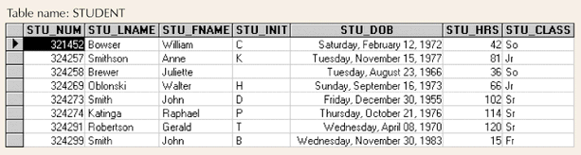
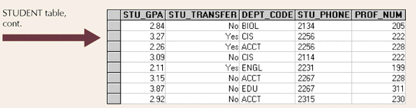
Example Tables
Figure 2.1

Slide 56
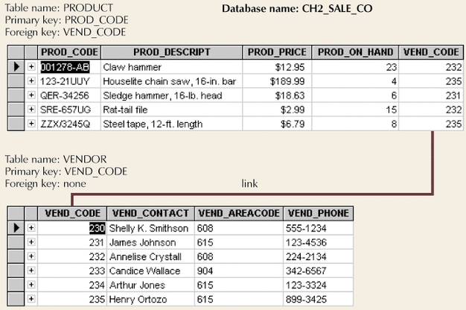
Simple Relational Database
Figure 2.2

Slide 57
Keys (con’t.)
Superkey
Uniquely identifies each entity
Candidate key
Minimal superkey
Primary key
Candidate key to uniquely identify all other attributes in a given row
Secondary key
Used only for data retrieval
Foreign key
Values must match primary key in another table

Slide 58
Integrity Rules
Entity integrity
Ensures all entities are unique
Each entity has unique key
Referential integrity
Foreign key must have null value or match primary key values
Makes it impossible to delete row whose primary key has mandatory matching foreign key values in another table

Slide 59
Relational Database Operators
Relational algebra determines
table manipulations
Key operators
SELECT
PROJECT
JOIN
Other operators
INTERSECT
UNION
DIFFERENCE
PRODUCT
DIVIDE

Slide 60
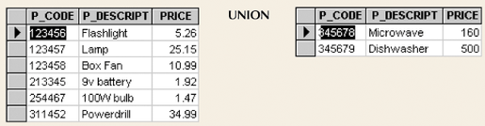
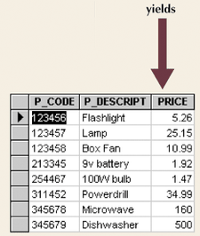
Union
Combines all rows
Figure 2.5

Slide 61
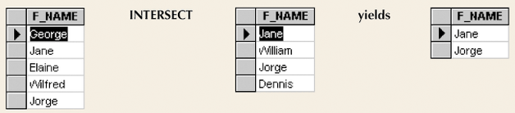
Intersect
Yields rows that appear in both tables
Figure 2.6

Slide 62
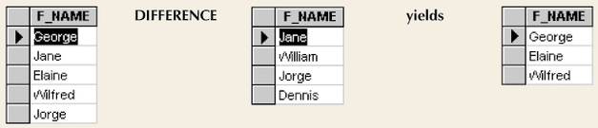
Difference
Yields rows not found in other tables
Figure 2.7

Slide 63
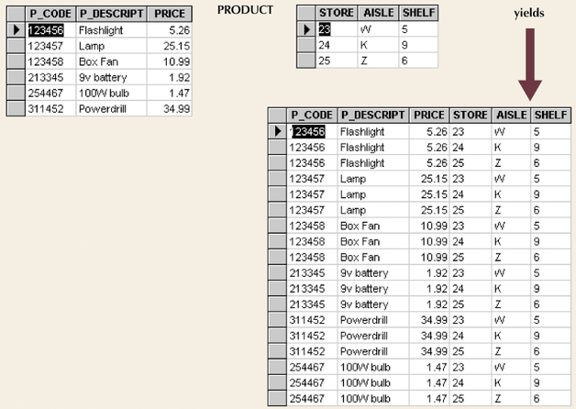
Product
Yields all possible pairs from two tables
Figure 2.8

Slide 64
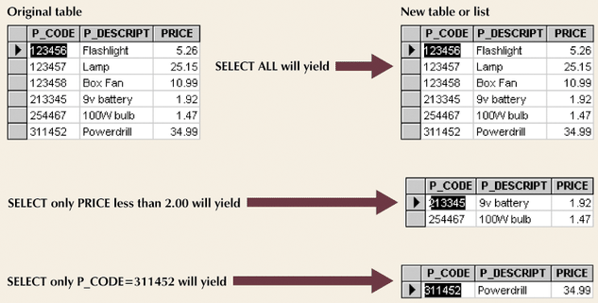
Select
Yields a subset of rows based on specified criterion
Figure 2.9

Slide 65
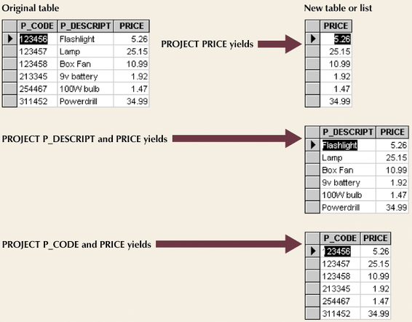
Project
Yields all values for selected attributes
Figure 2.10

Slide 66
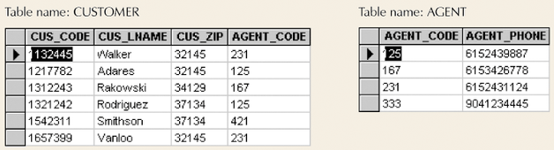
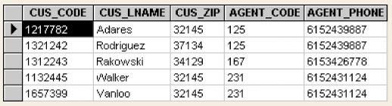
Join
Information from two or more tables is combined
Figure 2.11
Figure 2.14

Slide 67
Natural Join Process
Links tables by selecting rows with common values in common attribute(s)
Three-stage process
Product creates one table
Select yields appropriate rows
Project yields single copy of each attribute to eliminate duplicate columns

Slide 68
Other Joins
EquiJOIN
Links tables based on equality condition that compares specified columns of tables
Does not eliminate duplicate columns
Join criteria must be explicitly defined
Theta JOIN
EquiJOIN that compares specified columns of each table using operator other than equality one
Outer JOIN
Matched pairs are retained
Unmatched values in other tables left null
Right and left

Slide 69
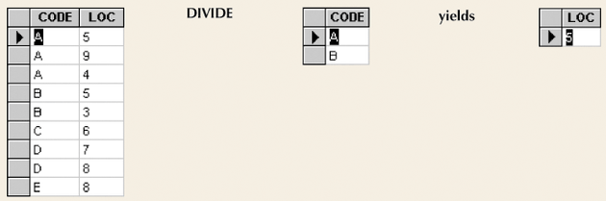
Divide
Requires user of single-column table and two-column table
Figure 2.17

Slide 70
Data Dictionary and System Catalog
Data dictionary
Provides detailed account of all tables found within database
Metadata
Attribute names and characteristics
System catalog
Detailed data dictionary
System-created database
Stores database characteristics and contents
Tables can be queried just like any other tables
Automatically produces database documentation

Slide 71
Thank you

